Slide 1



Machine Learning Foundations for Product Managers - Course Project
By:- Parth B Mistry

Slide 2

In this project, I developed a machine learning model to forecast the electrical energy output of a combined cycle power plant. I utilized a real-world dataset containing environmental variables and compared two models—Linear Regression and Random Forest—to achieve accurate predictions.
Main Points
Dataset: 9,568 rows, environmental variables, and power output.
Features: Temperature, Pressure, Humidity, Exhaust Vacuum.
Models: Linear Regression vs. Random Forest.
Evaluation Metric: Mean Absolute Error (MAE).
Best Model: Random Forest with an MAE of 2.47 MW.
Key Visuals: Feature importance, Predictions vs Actual, Residuals.

Slide 3

Step 1: Understanding the Problem
Problem Statement: Our goal is to predict the energy output of a power plant using environmental factors such as temperature, pressure, humidity, and exhaust vacuum.
The columns in the data consist of hourly average ambient variables: - Temperature (T) in the range 1.81°C to 37.11°C, - Ambient Pressure (AP) in the range 992.89-1033.30 milibar, - Relative Humidity (RH) in the range 25.56% to 100.16% - Exhaust Vacuum (V) in the range 25.36-81.56 cm Hg - Net hourly electrical energy output (PE) 420.26-495.76 MW (Target we are trying to predict)

Slide 4
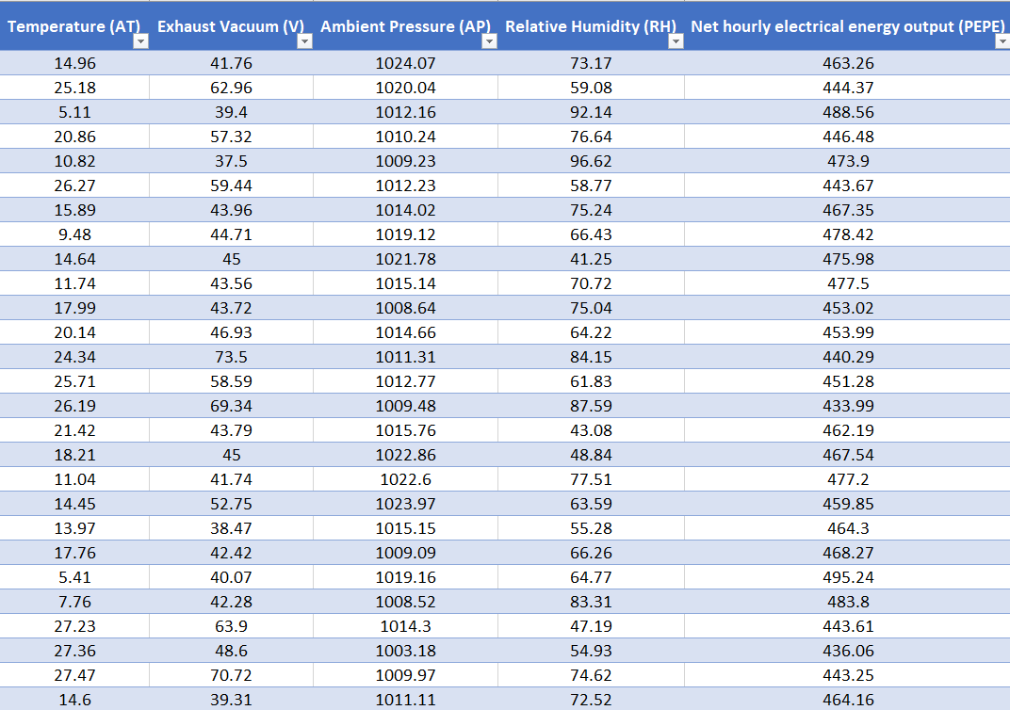
Dataset (Screenshot)

Slide 5


Step 2: Data Exploration and Feature Selection
Data Exploration: I began by checking for missing values and reviewing descriptive statistics to understand each variable's range.
Visualizing Relationships: I utilized pairplots and a correlation matrix to examine how features like temperature and pressure relate to energy output. The correlation heatmap revealed that temperature had a strong correlation with the target variable.
Feature Selection: Based on these findings, I chose four key features—temperature, pressure, humidity, and exhaust vacuum—for building the model.

Slide 6
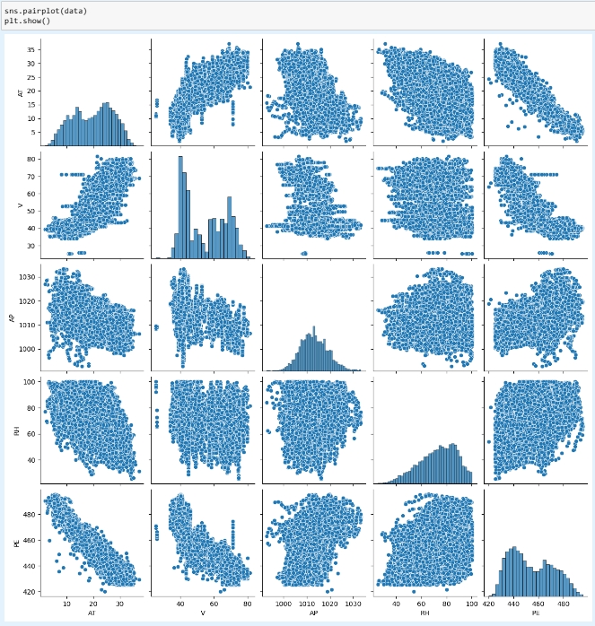
Step 2: Data Exploration and Feature Selection (Visualizing Relationships)

Slide 7
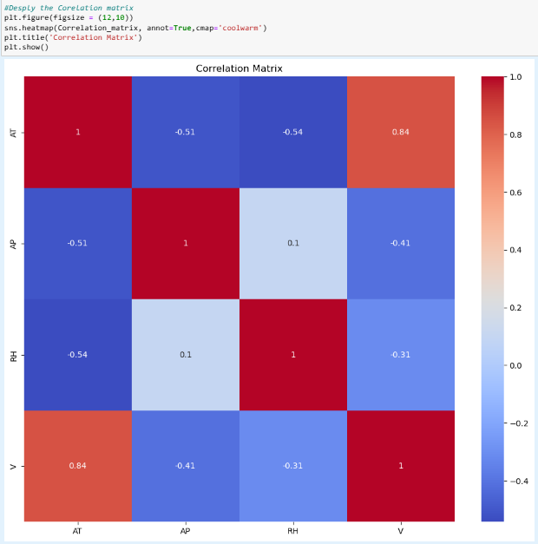
Data Exploration and Feature Selection (The correlation heatmap)
Understanding the Correlation Matrix
This correlation matrix visualizes the relationships between various environmental variables: Ambient Temperature (AT), Ambient Pressure (AP), Relative Humidity (RH), and Voltage (V). The matrix uses a color scale from red to blue, where:
Red indicates a strong positive correlation (approaching +1).
Blue indicates a strong negative correlation (approaching -1).
White represents no correlation (0).
Key Insights:
Voltage (V) and Ambient Temperature (AT) show a strong positive correlation of +0.84, suggesting that as temperature increases, voltage also tends to increase.
Ambient Temperature (AT) and Relative Humidity (RH) have a negative correlation of -0.54, indicating that higher temperatures generally coincide with lower humidity levels.
The correlation between Ambient Pressure (AP) and other variables is relatively weak, showing minimal direct relationships.
This matrix is crucial for identifying which factors are most interrelated and can help in predicting one variable based on the behavior of another in environmental studies.

Slide 8
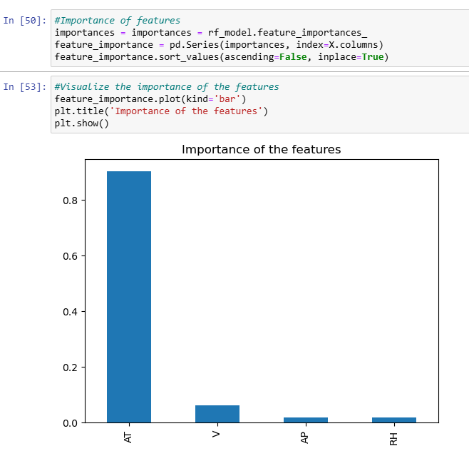
Step 2: Data Exploration and Feature Selection (Analyzing Feature Importance in Predictive Modeling)
Analyzing Feature Importance in Predictive Modeling
This bar chart represents the importance of various features as determined by a Random Forest model, highlighting how each feature contributes to the model's predictions. The features included are Ambient Temperature (AT), Voltage (V), Ambient Pressure (AP), and Relative Humidity (RH).
Key Observations:
Ambient Temperature (AT) is by far the most influential feature, with a significance score near 0.9, indicating a dominant role in the model’s output.
Voltage (V) and Ambient Pressure (AP) show relatively minor importance, suggesting they have less impact on the model's predictions.
Relative Humidity (RH) has the least importance, which may imply that it is the least predictive of the features considered for the model.
Understanding these feature importances helps in refining the model by focusing on the most impactful variables, potentially enhancing model efficiency and accuracy.

Slide 9

Step 3: Model Building and Comparison
Train-Test Split: I divided the data into training (80%) and testing (20%) sets to assess model performance on unseen data.
In Model Selection i compared two models
Linear Regression: A straightforward model that assumes a linear relationship between features and the target.
Random Forest: A more advanced model that uses multiple decision trees and averages their predictions for greater accuracy.
Cross-Validation: I applied 5-fold cross-validation to evaluate both models, providing a reliable measure of their performance across different data subsets.

Slide 10
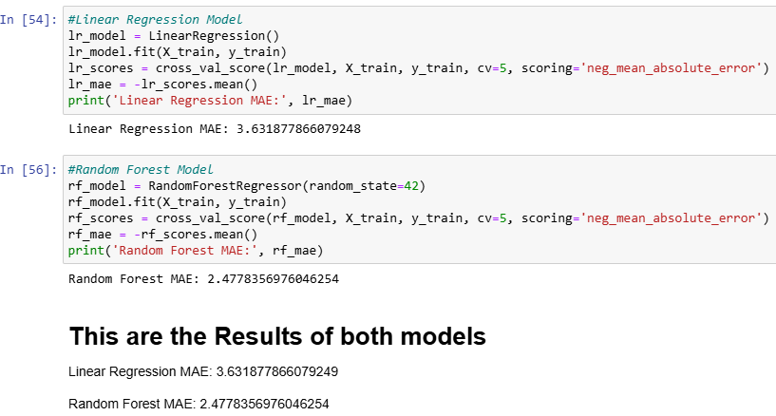
Step 3: Model Building and Comparison (Comparative Performance of Linear Regression and Random Forest Models)
This summary presents the Mean Absolute Error (MAE) results from two different predictive models: Linear Regression and Random Forest. The MAE measures the average magnitude of errors in a set of predictions, without considering their direction.
Key Results: Linear Regression Model produced an MAE of approximately 3.63, indicating the average error in the predictions when compared to actual outcomes.
Random Forest Model showed a significantly lower MAE of about 2.48, demonstrating a more accurate performance with fewer average errors.
These results highlight the effectiveness of the Random Forest model over Linear Regression in this specific scenario, suggesting that the Random Forest approach might be more suitable for datasets similar to the one used in this analysis.

Slide 11

Step 4: Model Evaluation
Evaluation Metric: I used Mean Absolute Error (MAE) to measure accuracy, which reflects the average difference between predicted and actual values. A lower MAE indicates better performance.
Results:
Linear Regression MAE: Approximately 3.63 MW, showing a higher average error.
Random Forest MAE: 2.47 MW, demonstrating superior accuracy compared to Linear Regression.
Best Model: The Random Forest model outperformed Linear Regression, so it was chosen as the final model for predictions.

Slide 12

Step 5: Final Model and Visualizations
Test Set Evaluation: I assessed the Random Forest model on the test set, and its Mean Absolute Error was consistent with the cross-validation results, indicating reliable performance.
Feature Importance: The Random Forest model provided insights into feature importance, highlighting that temperature was the most influential factor, followed by exhaust vacuum.
Prediction vs. Actual: I created a scatter plot to compare predictions with actual energy outputs. The close alignment of points to the reference line shows the model's accuracy.
Residual Analysis: I analyzed the residuals, which are the differences between predicted and actual values. The residuals were normally distributed, suggesting a good fit of the model.

Slide 13
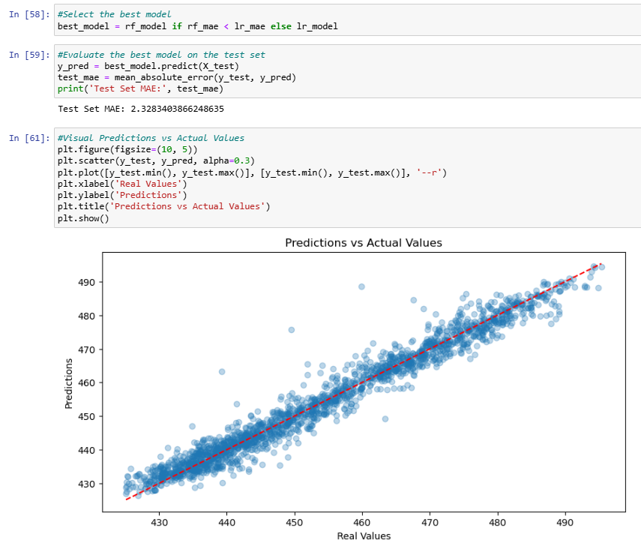
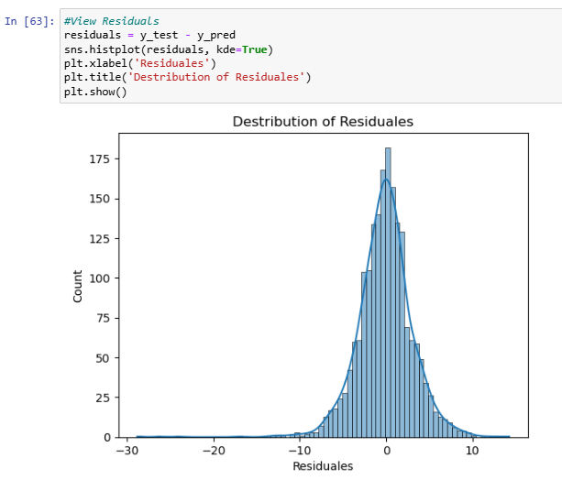
Step 5: Final Model and Visualizations

Slide 14

Conclusion / summary
We used two models—Linear Regression and Random Forest.
After comparing them, the Random Forest model was more accurate with a lower MAE.
I visualized feature importance, showing temperature was the most important factor in predicting power output.
This project highlights the importance of model selection, validation, and evaluation to ensure the best performance.
In this project, we aimed to predict the electrical energy output of a combined cycle power plant using environmental variables such as temperature, pressure, humidity, and exhaust vacuum. After exploring the data, we built and compared two models—Linear Regression and Random Forest. The Random Forest model performed significantly better, with a Mean Absolute Error (MAE) of 2.47 compared to 3.63 for Linear Regression. Key insights from feature importance showed that temperature was the most influential factor. This project demonstrates the value of using advanced models and careful validation to improve prediction accuracy.

Slide 15



